Slide 1
Session 7 Funding Through Sales

Slide 2
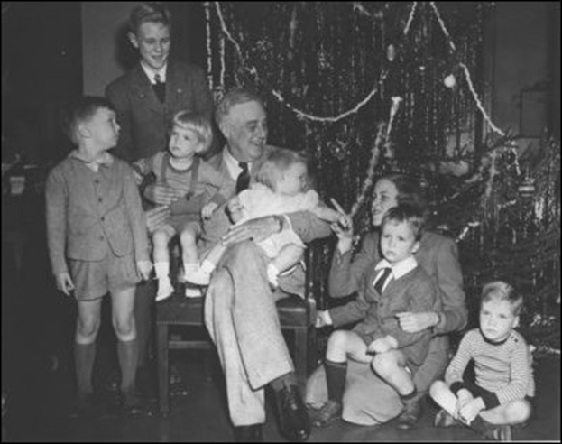
Funding through sales
“It is an unfortunate human failing that a full pocketbook often groans more loudly than an empty stomach.”
-Franklin Delano Roosevelt
Notes:
Principle 8 in The Lemonade Stand approach to business is “Funding through sales”.
Ask the class what they think “funding through sales” means?
Ask the class what they think the quote from FDR means?
How are they related?
Discuss the tendency for people to want to spend all the money they have instead of being resourceful, spending the least they can and making the most out of it.
Ask the class how this might help or harm a business.

Slide 3
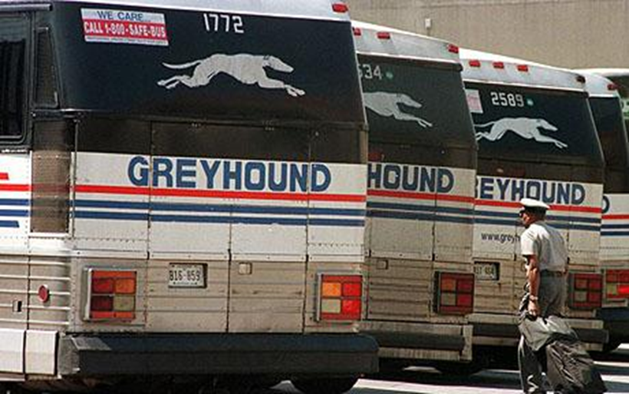
Funding without funds
Eric Carl Wickman’s story
Do you have to get a loan
Notes:
Discuss Eric Carl Wickman and his lemonhead story. How did he turn the situation of being laid off his job as a drill operator into an opportunity?
Did the first thing he tried work?
What ultimately happened?
One of the reasons people get stuck and don’t take action on their dreams is risk, but you don’t have to risk everything if you use The Lemonade Stand principles to start your business. You just need to use the resources in your reach right now.
Tell the class that the number one mistake that the authors see would-be entrepreneurs make is to think: “First I need to raise a million dollars, and then I can start my business.”

Slide 4
Effort vs. outcome
Taking someone else’s money – what happens?
Notes:
Discuss the story in the book about one of the author’s friends that took venture capital money and needed to show “effort” versus results.
When you take outside capital, your outcome – the goal you’re working towards – becomes their outcome. And an investor’s outcome is to recover their money and multiply it.
What happens if you want to change course or adapt your outcome after you take a loan or investor income? Your agility is greatly diminished.
Outside capital is not always a bad idea. Sometimes companies absolutely have to have capital to get off the ground, but the Lemonade Stand way is to avoid a loan if you can.
Family money also may be a mistake.
As soon as you take money from someone else – you have to answer to someone higher than yourself and you have to prove to them that you are making an effort. And proving an effort is useless – it is about the outcome.

Slide 5
Efficient lemonade
Create a prototype
Do more with less
Adapt
Notes:
Starting and funding your business through the sales from a prototype makes almost all the risks disappear.
Discuss the mock-up/prototype that the authors made for their e2Campus product.
What happens when someone gets a huge loan and then creates a prototype that no one wants? Where does the money for the next prototype come from? Does this seem like a good idea?
Discuss the carwash examples listed in the chapter. Discuss ways to start a business by prototyping instead of spending tons of money?
If things don’t work, companies need to be able to adapt, and it is hard to adapt if you have huge loan payments to banks or investors. Being resourceful and funding through sales eliminates a great deal of the risk and allows business owners to stay creative.
Ask the class if this has changes their perspective about the need for lots of capital when starting a business. What types of things did they think they HAD to have that may not be as necessary as they thought when starting a business?

Slide 6
Session 8 The A-Team

Slide 7
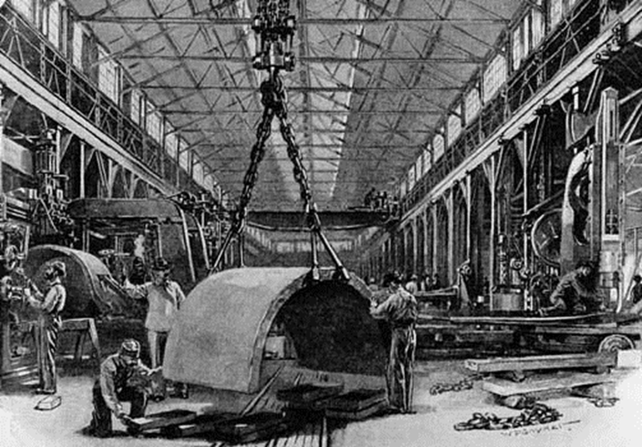
The A-Team
“Take away my people, but leave my factories and soon grass will grow on the factory floors. Take away my factories, but leave my people and soon we will have a new and better factory.”
- Andrew Carnegie
Notes:
Principle 9 in The Lemonade Stand approach to business is “The A-Team”.
Ask the class what they think Andrew Carnegie means in his quote.
A team can accomplish more than any individual. And a team is only as strong as its lowest performing member on any given day.
Discuss the example of the surgical team in the book.
When it comes to hiring, you need A players.

Slide 8
What is an A-Team?
Self-motivated
Multitalented
Entrepreneurial
Excited about what you do
Notes:
Having an A team is critical in your business, because when something happens or goes wrong, you need them to be there and ready.
You never know when you might have to call everyone and wake them up in the middle of the night. You need to know that your A team will be there and ready.
An A Team member is a person that is perfectly capable of running his or her own company on their own but is perfectly happy being part of a team. They have the skill sets, aptitude and attitude to take on multiple roles.
Having one A player is better than 10 C players.
The more multi-talented a person is – the better. The more flexible and powerful your business can be. The more the team can potentially overlap each other the better.
Make it a practice when interviewing or working with your team members to ask, “What else can you do?”
When your team members understand each others’ functions, they can communicate better and keep everything running smoothly.

Slide 9
How to find you’re A-Team
Recruit for your Delta Force
Hire for cohesiveness
Hire the smartest
Employ the Ingram Micro model
Notes:
Think of the hiring process as recruiting for the Delta Force. The Delta Force is an elite group of specially selected Army Special Forces. You have to be physically capable and skilled in particular areas, but you also have to be mentally and psychologically capable of handling the mission. This is what you want from your team. You want:
People that are really good at what they do
People that fit the dynamic of the team
Team cohesiveness is just as critical in business as it is in sports and the military. People deal better with people they like.
Also, do not be afraid to hire people that are smarter than you or better at your job than you are.
The easiest way to find people is to look in your network of contacts. Discuss how this works in the authors’ company.
Talk about the Ingram Micro example. The only way to get hired at Ingram is to be recommended by a current employee.
Once you create an A-team culture, you will not have trouble finding the right people. People want to be a part of a team like this, and you will have people waiting to come on board.

Slide 10
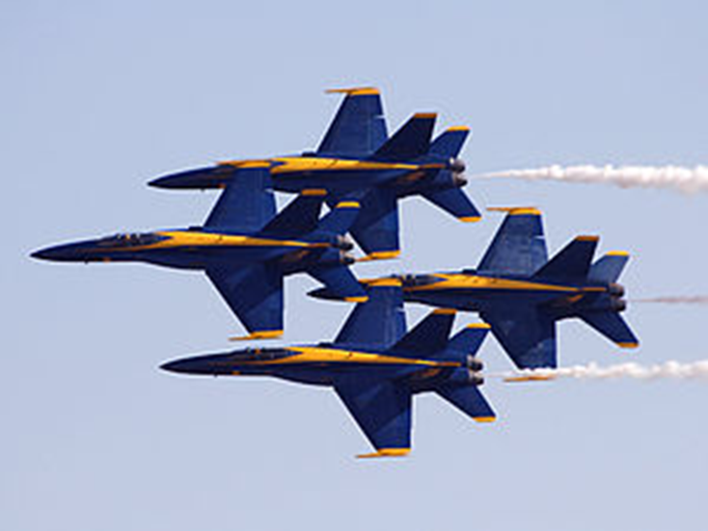
Building the best environment
The distributed workforce
A part of something special
“Glad to be here”
Flexibility through freedom
Notes:
Discuss the example the authors provide about the fact that the President of the United States does not commute for hours each day to and from work.
The authors have employees in several different states and around the world. They have a “distributed office”. Many people ask the authors “when are you going to grow up and get an office”, but they say “never”. The authors used to commute for hours – now they have that time to be more productive and enjoy more of their lives.
The benefits of this model include:
They can hire the best candidate for a job regardless of where they live.
Maintaining a full office of people is the largest expenditure in most businesses and since they don’t lease space – the authors are able to pay their team members more money.
Distributed teams tend to be more productive, because they can work whenever they feel like it and end up usually working more total hours toward success.
The authors’ team gets more freedom and flexibility in their personal lives and other pursuits.
People want to work in this type of environment, and the best environment is where employees feel like they belong to something special. Discuss the example of the Blue Angels and what the pilots say during the team debrief after every single flight demonstration, “Glad to be here, Boss.” Getting this level of commitment should be the goal of every A team.
Read the last paragraph in the chapter to the class. Discuss the elements of building an A team.

Slide 11
Session 9 Framework-Based Management

Slide 12
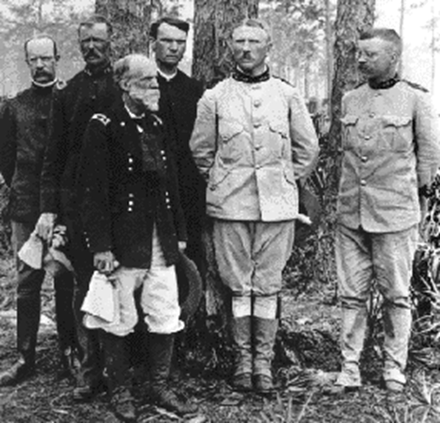
Framework-based management
“The best executive is the one who has sense enough to pick good men to do what he wants done, and self-restraint enough to keep from meddling with them while they do it.”
- Theodore Roosevelt
Notes:
Principle 10 in The Lemonade Stand approach to business is “Framework-based management”.
Finding and building you’re a team is crucial. But you still have to manage your people and steer the organization in a way that strengthens the culture you have created. An A team doesn’t work well with a supervisor looking over their shoulder all day.
Discuss how this impacts the surgery example from the last chapter.
Define micromanagement: It is the art of breaking everything down into figures so that people can try to prove what they are paid.
What happens when people try to micromanage their teams?
Would you enjoy being micromanaged? Do you think it helps creativity and problem solving? Why or why not?

Slide 13
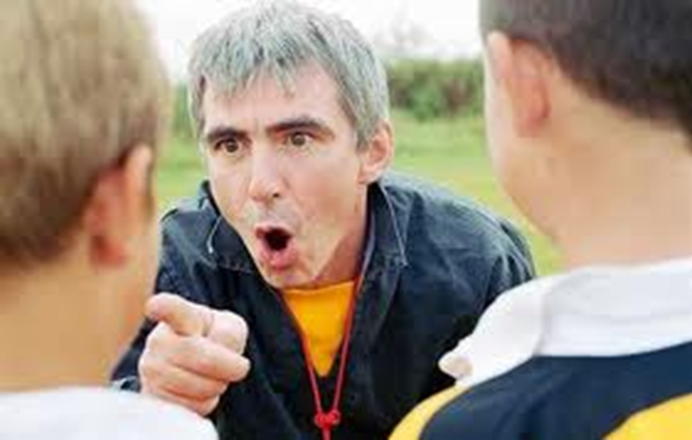
Instead of micromanaging
Let you’re A-team be themselves, don’t be overbearing
Encourage creativity and problem solving
Give them a framework and let them get results
Notes:
A-players will not hang around for long in an environment that doesn’t allow them to be themselves. These type of people are enthusiastic, skilled and innovative. Nothing will kill their enthusiasm faster than someone butting into their work.
It also does not help business in any possible way. Instead of micromanaging, you want to encourage creativity and problem solving within your organization with a framework-based management style.
This includes:
Giving your team members a job framework and the necessary outcomes
Allow them to do whatever they need within that framework to produce the desired results
Discuss the account manager example that the authors reference from their own company. Ask the class if they would like to work in a framework-based management organization.

Slide 14
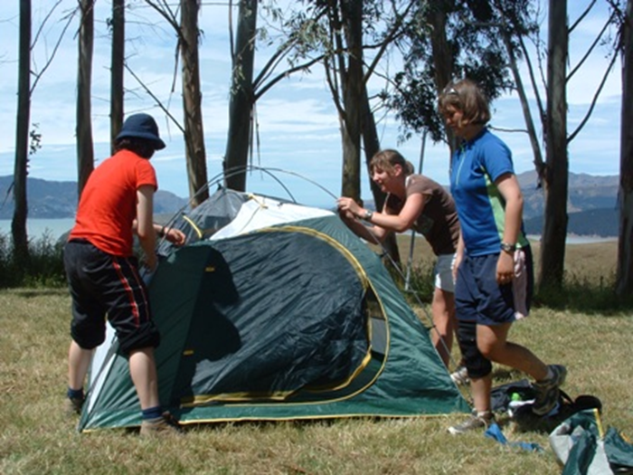
Motivate, don’t micromanage
Trust your team
Establish boundaries
Help them trust you
Lead by example
Notes:
To motivate a team you have to trust them. This is the most crucial factor in motivating people and the foundation of framework-based management. You have to establish boundaries and deliverables, but then trust the team to live within the framework and encourage them to take ownership of problems and outcomes.
Without trust, everything positive about the culture of your organization will crumble and fall apart. If you cannot trust someone to do their job, then you should not hire them in the first place.
To motivate people, they have to trust you too. Successful business owners lead by example. You need to take responsibility for your actions, regardless of the outcome. Then you need to expect the same from your employees.
Do not punish failure, but praise success. Taking responsibility for things is how the team should be measured.
Money is another way to motivate people, but it should not be the only way. Make sure your team is dedicated to the journey and the destination. Money should be like an added bonus.
Discuss how the authors direct their team in a visionary way rather than with nitty-gritty details. Go over the “Let’s camp over there” example given in the book and see what the students think about framework-based management.

Slide 15
Session 10 Scale Or Die

Slide 16
Scale or die
“Everything should be systematized and scalable, so no matter how many orders you get, the business still runs smoothly.”
- Ara Bagdasarian and Nick Gustavsson
Notes:
Principle 11 in The Lemonade Stand approach to business is “Scale or die”.
Having a business is about creating processes that can be executed successfully over and over again. Everything should be systematized so that it can scale. No matter how many orders you get, the business should still run smoothly. Many entrepreneurs overlook this in the beginning. They don’t think about the systems until it is too late and everything starts to fall apart.

Slide 17
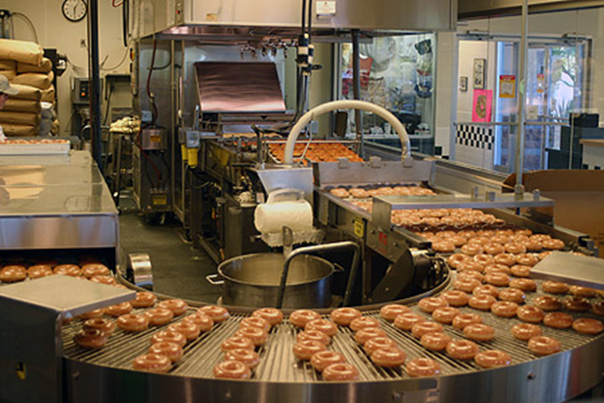
Make a process for everything
Production
Sales
Support
Add customer experience
Notes:
Discuss the donut example in the book. Ask the students where the business owner might have made the business more scalable through processes. Go through all the lemons that came up in this example. What would the class have done differently?
Also, what types of scalable ideas do the students have to improve the customer experience in this example?

Slide 18
Systems that serve – from the start
Build systems to serve
Follow perfected examples
Record everything you do
Make it scalable from the start
Notes:
Every business needs a system that can serve one as well as it can five hundred.
List Amazon as an example and discuss this example from the book with the class.
Discuss why the authors’ company would have fallen apart after the VA Tech shooting occurred if they had not had systems in place.
Automated processes are the ideal way to make sure you are ready to scale.
Discuss the author’s example about his regular prescription and then compare it to the experience of scalability at McDonalds.
Aside from knowing that you need a process for everything in order to be scalable – the key to setting up systems is to record everything you do as soon as you figure out how you want something to be handled. Design everything to be reproducible.
Once you create a process, write it down and follow it every time. Then when you bring in a team member, all you have to do is show them the system.
For many entrepreneurs, scalability is something they do not consider until it is too late. You want to serve your customers with a positive experience and having systems in place will allow you to do this no matter what happens.

Slide 19
Session 11 Build A Movement

Slide 20
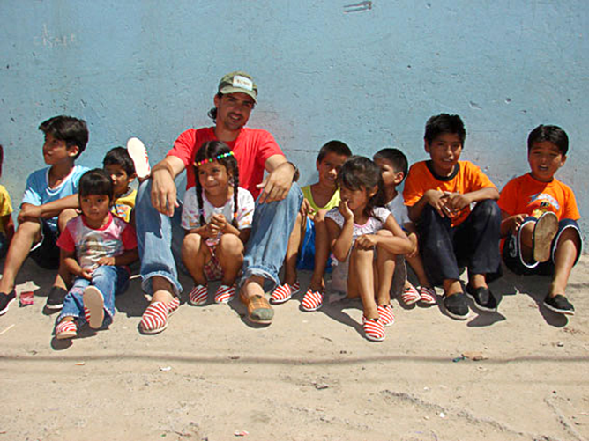
Build a movement
“Telling your story becomes a movement when your customers start telling your story for you. They actually become part of the story and part of your brand.”
- Ara Bagdasarian and Nick Gustavsson
Notes:
Principle 12 in The Lemonade Stand approach to business is “Build a movement”.
Telling your story is critical to any Lemonade Stand-type business.
Storytelling is the Lemonade Stand approach to marketing overall. The goal of doing this is to build a movement around your company, where customers are drawn to you because they want to be a part of what you and your company represent.
Discuss the Southwest Airlines example used in the book and show the video. Read the paragraphs in the book about this example to the class before your discussion. How is this video more powerful and impactful than a regular advertisement?
http://www.youtube.com/watch?v=rhMOnr0GxU8

Slide 21
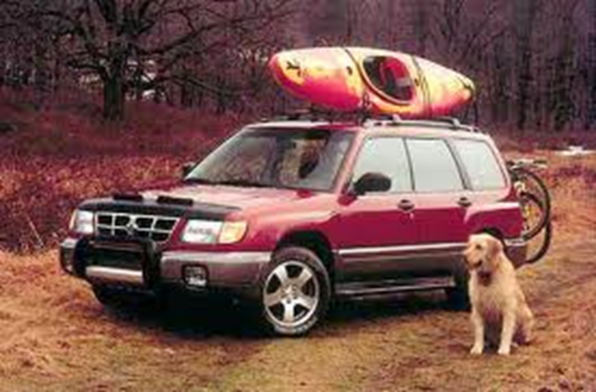
Planting your movement’s seeds
Momentum
Community
Contribution
Notes:
Building a movement is all about momentum. Momentum is the product of mass and velocity. By using all communication means possible to tell your story, you can build your mass. People will see that same story everywhere and start to associate it with you. By frequently communicating the progress of your story you increase your velocity. You get that same story to as many people as possible, and because it’s remarkable, they talk about it. This helps the story spread quickly. By building a meaningful story around your lemonade you are compelling customers to become part of your movement.
At this point the movement creates a sense of community that allows people to identify themselves with a group that stands for what you represent. Your movement is a fan club of people who believe in the same thing you do. Using your products and services allows them to be a part of something bigger. They are not just spending money, they’re contributing to the cause. They WANT to spend. They WANT to contribute.
Discuss the Subaru Forester example in the book. What has the Subaru come to represent to the people that buy one?

Slide 22
Keeping the movement alive
Product solves a problem
Something people care about
Remarkable experience
Great story
Sustain the movement
Notes:
Discuss the movement built around Jones Pure Can Soda.
Movement building is a combination of the principles we have studied so far.
If your business solves a problem that enough people care about, and you provide a remarkable customer experience and your tell the story so that people want to retell it to everyone they know, then all you need to do is keep it going!
You do this by continuing to use the lemonade stand principles and always being ready to see problems as opportunities.
Your primary job is to build on the movement so it sustains for the life of the business. Your stories will direct the movement and you are the leader that is responsible for feeding the storytelling needs.
Decide what you stand for and continue to find ways to support the cause you believe in. It further establishes your business at the center of it all and helps the movement grow even bigger.
Have a student read the last paragraph in the chapter, and then ask the class if they would like to start a business that stood for something?

Slide 23
Session 12 Build To Last

Slide 24
Build to last
“I learned from my uncle that jazz, like symphony music,
was built to last.” – David Amram
Notes:
Principle 13 in The Lemonade Stand approach to business is “Build to last”.
When you have followed the Lemonade Stand principles to create a business, it is built for sustainability. You have a market that loves what you do, you offer a unique experience that gets people excited, and you are constantly addressing problems as opportunities to fine-tune and improve upon the business.
At this point, your role shifts from craftsperson to maintenance person, and this makes most creative, problem-solving types antsy.
After you have built a successful business that is making money, shut out the competition and built the movement of people who love what you do – then you will want to start all over again. Since your business was built to last, You can find the next lemon and make more lemonade.

Slide 25
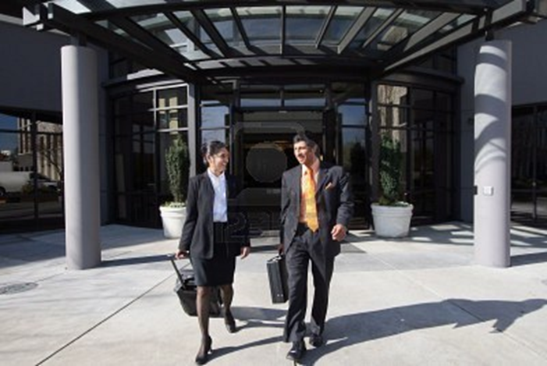
What’s next?
Sell the business?
Design yourself out

Slide 26
Cultivate new leaders
Get an employee not an entrepreneur
Empower leaders with decision making opportunities
Provide ownership
Notes:
One of the best things about running a Lemonade Stand business is that you put together an A-team of employees who understand what the business is really about. So the best place to look for new leaders to take over is in your A-team.
You want someone to stick with the company for the long term. You do not want someone that will learn everything and leave to go after bigger and better things.
How do you know? You observe the way they react when problems happen. You want leaders that analyze what happened and take away the positive while leaving the negative.
Once you have identified these leaders, start giving them decisions to make. When they come to you with a problem start asking them “What would you do if this were your company?”
The next thing is to give them ownership over a particular department or process and encourage them to innovate within that realm.
At this point you can groom the A-team to take over most of the day-to-day operations, and you an move on to the next lemon to be squeezed.

Slide 27
Session 13 The Lemonhead

Slide 28
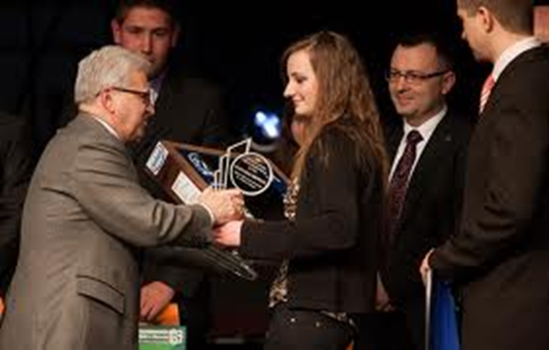
The Lemonhead
“It’s easy to make a buck. It’s a lot tougher to make a difference.”
- Tom Brokaw
Notes:
After you have trained yourself to see opportunities, to think in terms of outcomes and to innovate and problem-solve in everything you do, you have become what we like to think of as a “Lemonhead”.
Lemonheads are enterprising individuals who stand just ahead of the rest, on a slightly higher hill, looking out over the unknown, telling everyone else to come along. They see opportunities everywhere, they are never beaten and never out of the game, because they embrace the unknown – and that is where opportunity abounds.
Lemonheads are successful entrepreneurs who are always looking for ways to make lemonade, almost as if they’re seeing the world through lemonade colored glasses. This is when being in business really becomes fun.

Slide 29
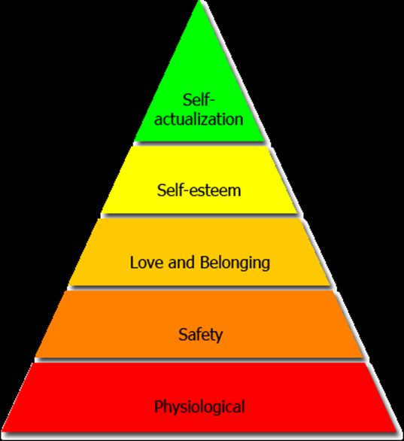
The Lemonhead stage
Your maximum potential
Solving more problems
Helping more people
Notes:
Once you have created success for yourself, now you want to make others more successful too.
Your business doesn’t need you all the time anymore, so this gives you an opportunity to start applying the principles to your community through charity, volunteering, mentoring, nonprofits and other projects that allow you to spread the good around.
The more problems you solve, the more you want to take lemons and create outcomes. That is where Lemonheads achieve satisfaction.

Slide 30
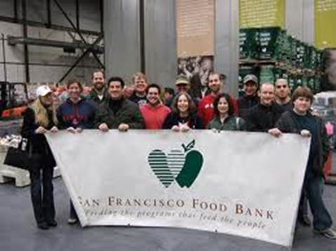
Beyond your lemonade stand
Apply the 13 principles to solving problems for the world
Volunteer your time
Spread the Lemonade Stand philosophy
Make lemonade!
www.lemonheadsrule.org
Notes:
Discuss all the ways that successful business owners can help their community and the world.
Tell the story of the Local Lemonhead Council that the authors started to support the mission of “empowering and inspiring the next generation of entrepreneur”. Review the LLC page with the students. Discuss other ways for entrepreneurs to volunteer their time.
Tell the class to imagine a world full of Lemonheads – people who embrace adversity, welcome challenges, convert problems into opportunities and improve lives. They do this by overcoming financial, personal and physical obstacles.
Remind the students that creating a successful business is within their reach.
No matter what you are starting from. As an entrepreneur and a lemonhead, you must constantly apply your perspective, drive and vision to improve the world we live in. Opportunities exist everywhere, and there are no limits to the amount of lemonade we can create, share and enjoy.

Slide 31
Session 14 What’s next?

Slide 32
Session 15 Lemonhead Guest Speaker

