Slide 1
Session 1 The Lemon

Slide 2
The Lemon
What is a lemon, and how do you make entrepreneurial lemonade?
Notes:
Instructor creates a dialog around the introduction in the book. Pages 9-21
Discuss what a lemon is in life. Have the class give their input in regard to what they think a lemon is for them on a day-to-day basis.
Discuss some problems in the world and how they might be able to make lemonade from the situation.
Provide an overview of the 13 principles. Pages 16-17
Inform the class that these principles were created through the authors’ own experiences owning multiple companies. (go to next slide)

Slide 3
Entrepreneurship – where do you start?
13 principles of successful entrepreneurship
Notes:
Tell the authors’ story and how they had multiple businesses before they finally became successful entrepreneurs with Omnilert. Each of the principles the class will learn in this program are things that Nick and Ara apply to their current business endeavors every day. They wrote “The Lemonade Stand” book to help other aspiring entrepreneurs and business owners create their own powerhouse companies.

Slide 4
The “Lemon” Economy
The Lemon of Unemployment is stifling tomorrow’s crop of burgeoning innovators
Notes:
Talk about the fact that the current economy is a Lemon for them. Even though jobs are tough to get and unemployment is high. This is an opportunity for them in many ways.
Ask the class what the opportunities might be in a down economy when unemployment is high. (frame this discussion in regard to entrepreneurship and business opportunities)

Slide 5
The “Lemon” Economy
The 13 Lemonade Stand Principles
What every entrepreneur should know to succeed in starting and running any business
Notes:
The economy is just a way another to make lemonade for entrepreneurs that use the 13 principles. The authors wrote this book for that specific purpose: to help every entrepreneur succeed. Tell the class to look at their book. It says the purpose on the cover. You can say to your class… “That is why I wanted you to study these 13 principles. Your teachers and everyone in the school system wants you to succeed and have the best training possible for your future.”
Have the class share some of the business dreams they currently have.

Slide 6
Optimism and embracing problems
Notes:
The first principle in “The Lemonade Stand” philosophy is Optimism. Optimism is the fuel of entrepreneurs. Without optimism, you won’t have the energy to keep going.
Every entrepreneur has experience with problems and times when things didn’t work.
Talk about the example of Thomas Edison. Read the paragraph about Edison on page 30 to the class.
Ask the class what happens when people quit because something doesn’t work. – They either miss an opportunity or someone else that is more optimistic and has more perseverance makes it work.
This is why embracing problems as opportunities is so important. As an entrepreneur you must see potential in every problem that arises.
You may also tell other optimistic Lemonhead stories here. For example Levi Strauss.

Slide 7
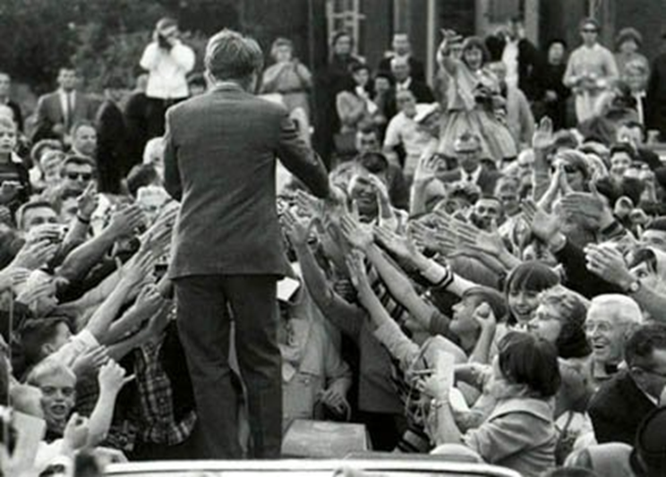
Pick your lemon and squeeze
“Some look at the world and ask, ‘Why?’ I dream big
and ask, ‘Why not?’” – Robert Kennedy
Notes:
The second principle is to “Embrace problems”.
Read the quote from Robert Kennedy, and discuss pages 35-38
Talk about the fact that Robert Kennedy picked his lemon and he took action. He squeezed. Ask the class what lemon Robert Kennedy chose. Talk about examples of other leaders that picked lemons to squeeze – for example Blake Mycoskie from TOMS Shoes. The instructor may want to search for current articles that exemplify this approach. The Internet is full of examples. New ones emerge every day.
Another idea is to have the class take a few minutes and search for examples to share and present them to the class (if time allows).
Make a point to say that entrepreneurs have to take action. When you don’t someone else will, and you miss huge opportunities. (next slide)

Slide 8
Pick your lemon and squeeze
Have you ever thought “That was MY idea”?
Notes:
Discuss pages 39-46
Once you pick your lemon, you have to take action on your idea.
Share the example of the Snuggie. Probably many people have thought of blankets as a poncho you can wear. But the people that thought of it and did not take action are not ones that made millions off a Snuggie. Ask the class if they have ever seen something and thought “That was my idea”
Ideas are worthless until you do something about them.
You have to act on your ideas to make them valuable.
Talk about the example on p45.
Read the summary on page 46 to the class or have a student read it. Then discuss what this means. Ask the class if they have any ideas that they haven’t done anything about.

Slide 9
Session 2 Outcome-based Thinking

Slide 10
Act for results
Outcome-based thinking
Effort without results is meaningless
Outcome-focused action creates new ideas
Notes:
Tell the class what the three main areas of learning for this session. Let them know that your goal as their instructor is to help them succeed and get the type of results they are dreaming of in business and in life.
Re-cap from the last lesson that ideas without action never happen. This lesson is about getting the outcome you are looking for with the right strategic action and limiting your focus on the obstacles. This is the outcome-based thinking approach to entrepreneurship.

Slide 11
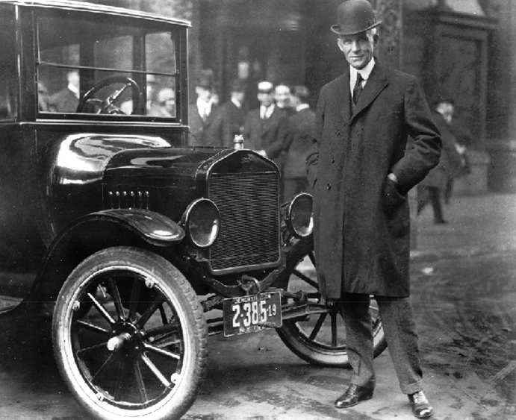
Outcome-based thinking
“Obstacles are those frightful things you
see when you take your eyes off your goal.”
- Henry Ford
Notes:
Have the students turn to the beginning of this chapter where Henry Ford’s quote is at the top of the page. Discuss the quote with the students. Ask them how this mindset relates to embracing problems as opportunities.
Discuss what happens when people focus on the problems or obstacles in situations. Ask the students if they have ever let this happen to them or know anyone that this has happened to – even their parents or friends.
Tell the class that in this lesson they are going to learn strategies to use in business, projects and general life that will help them overcome and avoid obstacles that may hinder their success. (next slide)

Slide 12
Outcome-based thinking
Ultimate goal is the top - Horizon
Tactical decisions along the way
Strategic decisions along the way
Notes:
“When you start thinking about the outcomes you want to achieve, consider not only what’s directly in front of you, but also what’s off in the distance. Every plan will have several degrees of outcomes that must be reached before you arrive at that final goal. If you are climbing a mountain, your ultimate goal is to reach the top. But to get there, you will have to step over rocks in the path, climb ridges and cross streams – you will have to make good decisions at every step. Some will be tactical decisions that you must deal with right away so you don’t stumble, and others will be strategic decisions that require planning and their own timeline of events.
Your highest level outcome – the one that is WAAAAAY out there is your horizon outcome. It is the ultimate vision for your business. Sometimes people call this a mission, but entrepreneurs should think about what the horizon goal is and work back from there.
Discuss the authors’ horizon goal with e2campus. (after discussing that horizon proceed to the next slide)

Slide 13
Outcome-based thinking
Where do you want to go?
Identify your horizon – Pick your lemon
The best businesses are solutions to problems
How do you know which lemon to squeeze?
Notes:
Identifying your horizon in business means picking your lemon. In other words, where do you want to go now? Remember that lemons are problems, and the best businesses are solutions to problems. Problems exist everywhere, so what are you going to solve? And how do you know which lemon to squeeze?
Your business will ultimately reflect you and your unique skills, talents and interests. The decision of what lemon to squeeze is very personal. These are the guidelines:
Thinking back to your horizon or big picture goal and the impact you want to make on the world
Your vision is what the world your be
Then align your person vision with your business vision
The business will represent you and your passion
You can REALLY put everything into a business that is designed with that kind of horizon in mind
The horizon always has to be in sight so you know where you are going
Discuss why keeping your horizon (or vision/mission) in mind at all times is important – as stated in the book.
Discuss the fact that the authors say is it ok to shift your horizon. Why is it important to be agile as an entrepreneur? What things can change that entrepreneurs do not have any control of? STATE: The best goals drive you to get up in the morning. (next slide)

Slide 14
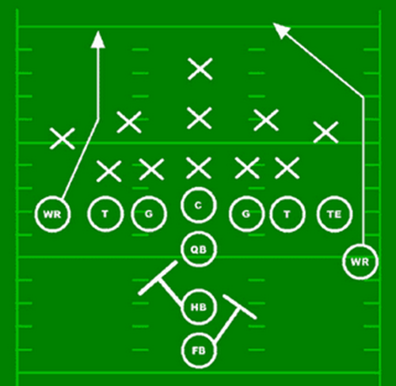
Outcome-based thinking
Game plans and business plans
Action-based approach
Success is not about effort or ability; it’s about results
Task-oriented
Notes:
A business plan is a lengthy document that explains the business financial and operational projections. It contains detailed sections on the market and the competition, makes projections about where the business will be years in the future and is used to convince potential investors that you will use their money wisely.
Business plans are not bad things. Plans are good, but they need to be action focused. You need to have a game plan. Figure out what you want to accomplish, and then figure out what actions need to be taken to make it happen.
Unlike a business plan, a game plan identifies the next action. Every step is some action that must be taken to reach your horizon line. Creating a task-oriented game plan is simply a matter of breaking everything down into smaller outcomes and the step-by-step actions to realizing them. Your horizon guides all your decisions.
Make a game plan and define yourself by what you WILL accomplish in the future. Do not be scared to communicate your future horizon to people. Use these steps:
Define your horizon or vision that you want to accomplish.
Create an action plan that consists of the steps you will take to reach the goal.
Focus on what you WILL do.
Manage your expectations.
Let your horizon guide you. (Discuss the different ways to address business planning with the class. Ask them what the authors recommend and why. Also talk about other approaches that could be used. Ask the students what they feel most comfortable with and why?)

Slide 15
Session 3 Do Not Compete

Slide 16
Stick out in a crowded market
Do not compete
Be extraordinary
Notes:
The authors talk about one of the most common questions they get from other business owners: “How do you compete with the ‘big guys’ when you don’t have all the capital, resources and employees?”
Talk about the fact that all businesses need to differentiate themselves in some way. Some common ways are price, customer service, convenience (location), personal service….these are ways to use the marketing mix to be unique.
The Lemonade Stand Approach is to be unique and extraordinary by what the authors consider their “do not compete” philosophy. You do something so different with your business that you do not have to worry about what your competitors are doing. De-commoditize your business and go after a unique niche that the other companies are not focusing on. NEXT SLIDE

Slide 17
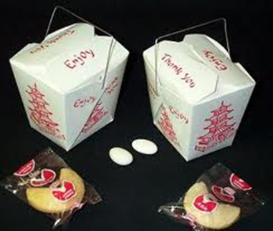
Create your own market
Define de-commoditize
Find a niche market
Notes:
Discuss the definition of the word commoditize with the class: Commoditization is the process by which goods that have economic value and are distinguishable in terms of attributes (uniqueness or brand) end up becoming simple commodities in the eyes of the market or consumers. It is the movement of a market from differentiated to undifferentiated price competition and from monopolistic to perfect competition.
Talk about the example in the book on pages 70-71 in regard to the way P.F. Chang’s entered the already-crowded Chinese food market.
Discuss how the authors approached the emergency notification market. They saw that the government and corporate markets were already full and found that the higher education market was a lemon waiting to be squeezed.
Talk about how the authors’ company came to set the standard in their market. Discuss the approach the authors used to get to the point where their company became the standard for the college campus safety market. NEXT SLIDE

Slide 18
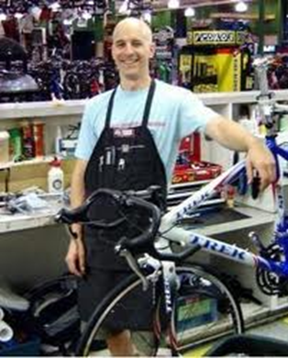
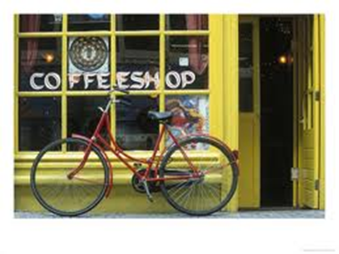
Be extraordinary
Solve a problem
Do it in a remarkable and unique way
Know the implicit value of what your business does
Notes:
Using the Lemonade Stand approach that solves a problem with the business you create helps you avoid starting a business simply for your own satisfaction. If you are not solving a problem or contributing anything to the community, then this will limit your success.
You need to solve a problem and do it in an extraordinary way. That creates a remarkable experience for your customers.
Discuss the three examples the authors list on pages 73-74. How did each business come into a crowded market but still create a remarkable experience.
The authors discuss a coffee shop, a bike mechanic and a car wash. Which of the 3 pictures show a remarkable and unique way to approach that type of business? Does the class think car washing superheroes might work and be a fun experience for someone getting their car washed with their children?
Get the class to really brainstorm about ways to be extraordinary in markets that have become “same-old-same-old”.
Have the class talk about business they interact with regularly and what is remarkable or extraordinary about them.

Slide 19
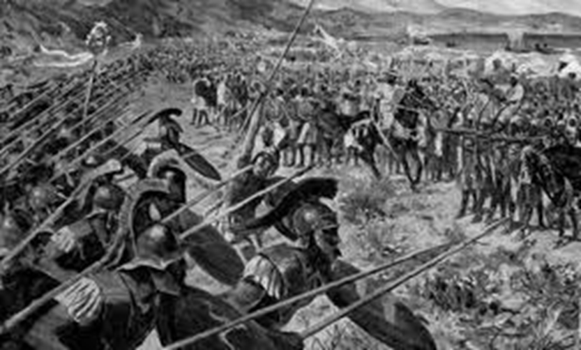
Become the market leader
Define the battlefield
Hold your ground
Notes:
When the Persians sent their fleet of 600 ships to invade Athens, the outnumbered Athenians defeated them despite their size, because they chose the battlefield. They used the terrain to their advantage, and put the Persians in a position where their superior numbers would not make a difference.
The authors advocate identifying an untouched market niche and establishing a foothold there. This gives a business the same type of advantage as the battle example – YOU CHOOSE where you want to operate in the market. That makes the other businesses’ resources irrelevant if you choose a battlefield where those resources are not helpful.
Discuss this concept in relation to the authors’ business in emergency notifications.
Have someone read the paragraph in the middle of the page on p78. Discuss some ways that staying small can be an advantage. Ask the class about other situations where the perceived “underdog” won a contest or business battle. Or have them list characteristics that are seen as “weaknesses” that become strengths or opportunities. Like Mark Zuckerberg being a geek that needed to look at potential dates online…but now that is FB. See what else they come up with.
Discuss the “me too” businesses that will crop up. What do the authors say to do when competitors try to come into your niche? Hold your ground and maximize your status as a pioneer. You can showcase what a leader you are each time a new business comes into your market.

Slide 20
Session 4 Tell Your Story

Slide 21
Your business has a story
“People have forgotten how to tell a story. Stories don’t have a middle or an end any more. They usually have a beginning that never stops beginning.” – Steven Spielberg
Notes:
The way marketing used to be done is over. This is true of many disciplines since the dawn of the information age. Marketing messages that include features and benefits will not suffice to sell products and services anymore. Features and benefits are important facts about what your product or service provides for customers, and they give people logical reasons for buying. However – they do not appeal to people on an emotional level, and statistics show that people buy based on feelings more than facts.
Facts also do not give people a feeling that they are a part of something bigger. Stories do. Stories provide the feeling of connection that gets people purchasing. New marketers and entrepreneurs have to be great story tellers.
The Lemonade Stand way to “market” is to tell a story about you and/or your offering. Why did you get started in business? Who uses your products? What problem are you solving? What makes you different? Doing this not only cuts through the noise, but it makes your business stand for something – which is so much more appealing than features and benefits.
Ask the class which shoes they want to buy? Which company has a compelling story that also markets their product?

Slide 22
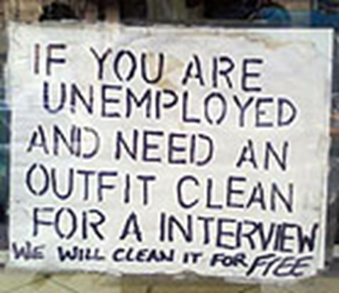
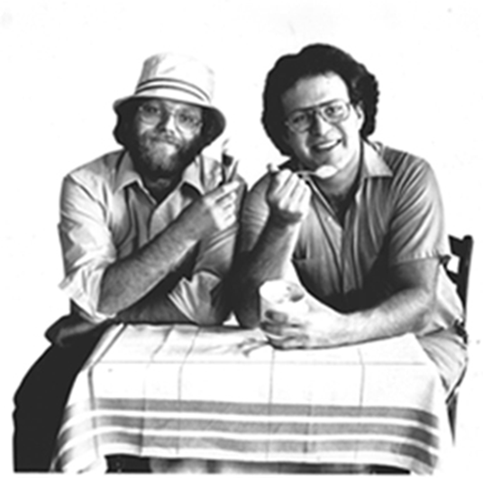
Powerful business stories sell
See a need and fill it
Carlos’s story
Ben & Jerry’s story
Notes:
Discuss Carlos Vasquez’s story on pages 82-83, what lemon did he squeeze, how did his poster capture the story of the down economy?
Discuss Ben & Jerry’s story. What lemon did they squeeze? What is compelling about their story? What is extraordinary about the customer experience with their product?
Discuss the author’s brand: RainedOut. What lemon is it squeezing? What is the story behind that product?

Slide 23
What’s your story?
You have a story
Balance the intellectual with a story
Your story distinguishes you
Stories center on a problem and are repeatable
Notes:
A core principle behind establishing yourself and your business is telling a meaningful story about your lemonade that gets people excited about what you do and makes them feel like they are part of something bigger.
This take the business beyond just seeing an opportunity to make tons of cash.
Balancing the intellectual with a story makes whatever you do more meaningful and even more valuable to the customers you serve. Stories are memorable, and people connect and understand stories on an emotional level. Your story distinguishes you from any competitors that exist in your market by showing you are worthy of being better than everyone else.
All stories center on a problem, like kids not having shoes or crimes on campuses. And eventually lead to a solution, which is your product or service. Stories are repeatable – people share stories and share your message for you.
Discuss how stories can help you identify a business niche. Discuss the fact that once you have your story, you need to leverage it every chance you get.
Discuss the town of Leesburg example in the book and why no marketing or advertising could have gotten the same results as the task force and its success stories with the local business community. How did the town capture and use this?

Slide 24
The media is your partner
Storytelling tools
Press releases
Case studies (print and video)
Social media
Electronic newsletters
Blogs
Speaking engagements
Editorials
Notes:
One of the most important relationships you can build for your business is with the media. Getting interviewed and mentioned in newspapers and magazine articles cost virtually nothing when compared to the amount you might pay for advertising. And it’s much more effective, because it positions you as an expert and a solution, versus a sales person.
Advertising is selling something. Having a story published about you and how your offering solves a problem connects with prospective customers much more effectively.
Press Releases are the best place to start building relationships with the media. Discuss pages 88-91 How did the authors use press releases to position themselves as the expert in their field with the media?
Review the “storytelling tools” listed on pages 91-93.
Close by reading the last paragraph on page 93. Ask the class to discuss some powerful business stories that they know.

Slide 25
Session 5 The Experience

Slide 26
The experience
“Disneyland is a show.”- Walt Disney
Notes:
People buy experiences; they do not buy products. Microsoft doesn’t say “user interface” anymore, they call it, “user experience”. You’re not browsing online; it’s an “online experience”.
Everything is about the experience. Walt Disney knew that the experience was everything years and years ago. Everyone has been to amusement parks, but Disney made a whole new world and a completely different experience out of something that had been done many times before.

Slide 27
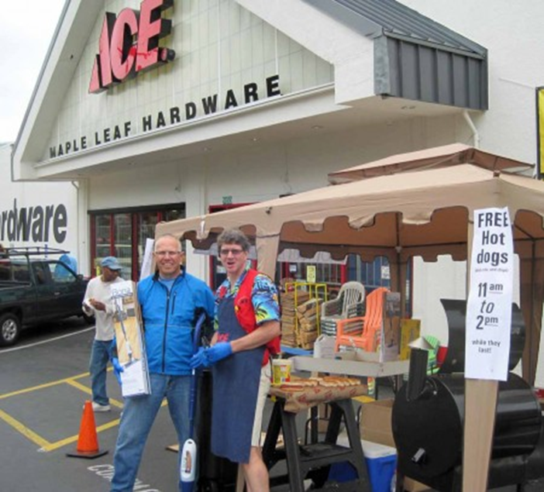
The experience
What you’re selling becomes something else
Lawn mowing
Electrical supplies
Grocery stores
Notes:
Discuss the examples in the chapter about lawn moving, the author going to purchase electrical supplies and Bloom grocery store.
Ask how the same products and services can become something else entirely if the customer experience is enhanced.
When you create an experience, what you’re selling becomes something else, and often something people are willing to pay more for. NEXT SLIDE

Slide 28
The experience
Apple iPod
Choose your lemon
Make the experience outstanding
Notes:
When Apple introduced the iPod there were several other mp3 players on the market. But no one really cared about having an mp3 player until the iPod created the experience of having thousands of songs in your pocket.
Discuss this campaign and how it made Apple’s product more than an mp3 player.
Discuss the carwash example in the book.
Tell the class that when they choose their lemon, they should also think about how they can make the experience outstanding for their customers.
Sometimes the lemon may actually be an opportunity to create the experience.
Discuss the example of Starbuck’s and P.F. Chang’s.
See if the class can come up with any other examples of outstanding customer experiences that make a product more than what it is.

Slide 29
Be customer-centric REALLY
Fill a unique role in the marketplace
Tell the story
Create an experience worth talking about
Create fanatical endorsers
Notes:
Lots of companies say that their customer comes first, but everyone knows that people have become skeptical of that. The reason we hear it, is because it’s important, but we have all experienced times we did NOT come first.
When customers do not come first it is really saying, “We care more about taking your money than supporting you after the purchase.” This is no way to keep customers, and it is no way to run a Lemonade Stand business.
The Lemonade Stand way is to put customers first. The authors say this should be one of the ten commandments of being in business, because it is right AND customer retention is one of the most critical parts of the Lemonade Stand. Your ultimate goal is to create fanatical endorsers – which is achieved by everything we have covered up to this point.
Go over what has been covered so far.:. filling a unique role in the marketplace, telling the story, and creating an experience worth talking about. Now that the customer is engaged, you have to keep them coming back for more. Going out of the way for your customer is easy. It costs virtually nothing, and it is one more way you can level the playing field with the big guys.
Discuss the record store example. Get class feedback on all the ways this experience could have been different.

Slide 30
Be customer-centric REALLY
Everyone contributes to the experience
Make support easy to access
Notes:
To really create a customer-focused business, everyone on your team must align his or her beliefs and actions with this philosophy. Everything they do at work must contribute to the experience your customers have with your company.
This means:
Being available
Being helpful
Always a representative of the company
*Every person in the company is really a salesperson. Everyone is responsible for your customers’ best interests. No one says “it’s not my job”.
Discuss the Disney Cast Member philosophy.
Discuss how being customer-centric gives the team a whole new outlook on what their job is and what the company is trying to achieve.
Where does the customer-centric focus come from? Leadership. The authors do not demand that their team members follow, they do because they are passionate and invested in what the company does for its clients.
It costs money to get a new customer. Everyone that calls you or walks through your door is a result of your storytelling and press releases and marketing. Give them easy access to getting help. So many companies do not do this. Discuss examples.

Slide 31
Be customer-centric REALLY
Help them buy
Notes:
No one likes to walk into a store and feel like the staff is swarming all over them. No one likes high pressure sales situations. No one likes to be sold; but EVERYONE LIKES TO BUY!
If you can create an environment that helps your customers make a buying decision, rather than pushes them to a sale:
They’ll enjoy the experience more
They’ll spend more money
They will be more likely to come back
They will spread the word to their friends.
This subtle shift helps create an entirely different atmosphere and experience for the customers.
Discuss how Barnes & Noble and CarMax help their customers buy. (NEXT SLIDE)

Slide 32
The experience
Help them buy
Notes:
Discuss the author’s experience in the Caribbean with the taxi cabs. Compare and contrast the outstanding experience with the horrible one.
If your business doesn’t center on your customers and creating an extraordinary experience for them in some way, you are left with a solution to a problem that will never reach its potential to serve. You will also leave a gap where a competitor has the opportunity to come in and improve upon what you are doing. They won’t have any problem at all, because your customers will happily leave for a better experience.
You must create happy customers, and their experience with you and your product is a primary way to achieve this.

Slide 33
Be resourceful
“There’s nothing more dangerous than a resourceful idiot.”
– Scott Adams
Notes:
Principle 7 in The Lemonade Stand approach to business is to “Be resourceful”.
Resourcefulness is a quality that, if you can master it in the start-up phase, will serve you well for the lifetime of your business. So with your business outcomes in mind, the next step is to assess your resources and figure out what tools are available to realize your outcome.
Discuss the way companies used all their investment capital in the Dotcom boom.
In business you need to:
Use what’s available to you
Use what you can afford
Use what you absolutely need to serve your customers to create a remarkable experience for them
Anything else is UNNECESSARY!
Discuss the quote and how it relates to Principle #7. It is basically saying that being resourceful can be more of an advantage than being smarter or having the most resources. It is about doing the most with what you have.

Slide 34
Leverage technology
Look big when you’re still small
Be more agile and efficient
Notes:
We live in an unprecedented time where so much has advanced with technology that many of the tools that were once only available to the big corporate conglomerates are now available to everyone. The playing field is level, because so much has been standardized, and it is easier to look big in business when you are still small.
Discuss the example of the Industrial Revolution and the standardization of screw threads and general measurements. How did this change the world?
This is the same way that the internet and technology have changed the world of business today.
Ask the class what are some of the ways that technology makes entrepreneurship more easy?
Business owners can be resourceful and agile in ways that make your business and your processes more efficient.

Slide 35
Outsource everything you can
Outsource everything you can, but not more
Focus on what you do best
Define the outcome
Pay by project
Manage your outsourcing balance
Notes:
When people start out they usually get used to doing everything themselves in their business. They cover all the major roles of bookkeeper, sales team, customer support and human resources.
As your business grows you can be more productive and efficient if you outsource some of the ancillary aspects of the business. You want to focus on doing what you do best.
You can outsource almost anything these days. Some examples:
Marketing material creation
Shipping
Customer support
Ask the class some other things that might be outsourced.
When outsourcing aspects of a business define the outcome of the project and pay on that outcome – rather than an hourly rate.
Remember that you do not want to outsource too much. There are times when you do not want to outsource:
When the company you outsource to cannot represent your level of care and quality
When the vendors you outsource to are not able to comply and complement what you are doing with your business standards and mission.

Slide 36
Make resourceful lemonade
Use resourceful marketing tactics
Use what you have
Make it happen without spending all the money
Notes:
Whenever you are faced with an opportunity to market your business and tell your story in a big way – do not let the cost stop you. This becomes one more way to take a lemon and make lemonade. Figure out a way to use what you have an make it happen without spending all the money.
Discuss the authors’ example of resourceful marketing in reference to the tradeshow. Have the class list some of the ways the authors were resourceful in creating a big impact with creativity and resourcefulness on a small budget.
Discuss the idea that most people think entrepreneurs are risky by nature. This is not the truth. Being in business is about being creative and being resourceful, and it should involve minimum risk.
The next lesson focuses on one of the ways to minimize risk, but for now, just understand it can be done.
Don’t see a lemon and then get stuck thinking, “I don’t have the money to do this.” Be creative and resourceful.
-Use what is available to you.
-Outsource projects rather than hiring employees
You can successfully start, run and market a business without spending thousands and putting everything on the line.

